Slide 1

Development of the Central Asian Higher Education Area
based on the principles of the Bologna Process
K.A. Yergaliyev
MD MPH Dr.PH
Vice-minister of Science and Higher Education
of the Republic of Kazakhstan

Slide 2
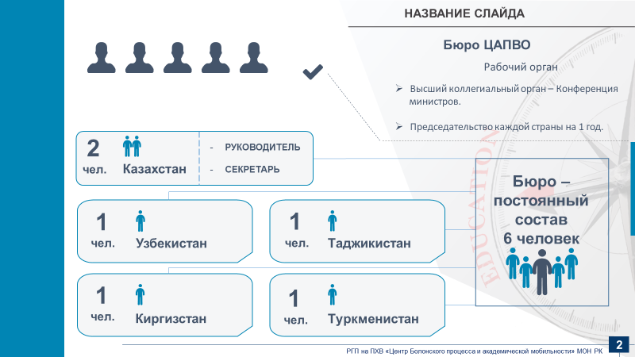


The history of the creation of the Central Asian Higher Education Area
THE FIRST MEETING OF MINISTERS FOR EDUCATION OF THE MEMBER STATES OF THE EUROPEAN UNION AND OF THE CENTRAL ASIAN COUNTRIES
2015
THE SECOND MEETING OF MINISTERS FOR EDUCATION OF THE MEMBER STATES OF THE EUROPEAN UNION AND OF THE CENTRAL ASIAN COUNTRIES
2017
TuCAHEA
TUNING OF CENTRAL ASIA HIGHER EDUCATION AREA
2012-2016
CENTRAL ASIAN EDUCATION PLATFORM (CAEP)
2012-2019
TuCAHEA foundations have been laid for the formation of the NQFs and the use of ECTS in the region
The project of the European Educational Initiative for Central Asia
Commitment to strengthen further mutual beneficial cooperation in the field of education, within the context of the EU-Central Asia Strategy
Dissemination the ideas of the Bologna Process in the Central Asian region
Development of Central Asian Higher Education Area
Joint Communique and Roadmap of Activities
Astana Declaration
INTERNATIONAL ONLINE FORUM "GLOBAL IN REGIONAL: KAZAKHSTAN IN THE BOLOGNA PROCESS AND EU PROJECTS”
2020
CONFERENCE OF CENTRAL ASIAN EDUCATION MINISTERS
2021
CENTRAL ASIAN UNIVERSITY RECTORS' FORUM
2022
RECTORS' CONFERENCE
WITH THE PARTICIPATION
OF REPRESENTATIVES
OF THE BFUG, MINISTRIES
AND UNIVERSITIES
OF CENTRAL ASIA
2022
Ministers of education of Central Asian countries proclaimed the creation of the Central Asian Higher Education Area
Establishment of the Alliance of Central Asian Universities
Creating the Bureau of the Central Asian Higher Education Area on parity terms
Idea of creation of the Central Asian Educational Area
Turkestan Declaration
Memorandum
Joint statement
1

Slide 3
TuCAHEA – Tuning of Central Asia Higher Education Area
2012-2016
Purpose: to contribute to the development of the higher education area of Central Asia, in accordance with the European Higher Education area, to take into account and assess the specific needs and potentials of the region as a whole and partner countries in particular, responding to the needs of higher education in particular and society as a whole.
Results:
use of competence-based tools and tools to improve the quality of curriculum development
improvement of regional higher education systems
creation of a knowledge exchange platform
creation of pilot Tuning groups in subject areas
improvement of mobility tools: improving the quality and transparency of recognition.
TuCAHEA foundations have been laid for the formation of the NQFs and the use of ECTS in the region
2

Slide 4
CENTRAL ASIAN EDUCATION PLATFORM (CAEP)
2012-2015 (I), 2015-2019 (II)
Purpose: to contribute to the programs of the Central Asian countries aimed at improving the competitiveness and productivity of the national economy, as well as the potential for sustainable development in the region. The main objective was to provide the services necessary to ensure smooth progress in the implementation of the EU Education Platform in Central Asia, supporting its goals and activities as agreed between the EU and partners from Central Asia.
Results:
improved dialogue between Europe and Central Asia in the field of education
improved the quality of mutual learning in different countries
experience, lessons learned, exchange of best practices
evidence-based policy approach initiated
exchange of people and improvement of mutual understanding
improved support to local stakeholders for more effective implementation of reform programs at all institutional levels.
empowering policy makers through analysis and training.
3

Slide 5
The First Meeting of Ministers for Education of the Member States of the European Union and of the Central Asian Countries
Riga, 25 – 26 June 2015
in cooperation with the European Commission and the European External Action Service.
commitment to strengthen further mutual beneficial cooperation in the field of education, within the context of the EU-Central Asia Strategy
Main points of the Joint Communique:
Development of Qualification Frameworks (QF) and Standards
Quality Assurance (QA) and Accreditation
Employment and Labour Market Needs
Indicative Roadmap of Activities under the “Central Asian Education Platform” (2015-2018)
4

Slide 6
The Second Meeting of Ministers for Education of the Member States of the European Union and of the Central Asian Countries
within the framework of the European Union - Central Asia Education Platform (CAEP) project
Dissemination the ideas of the Bologna Process in the Central Asian region
Development of Central Asian Higher Education Area
The Astana Declaration was accepted
The declaration intends to expand educational cooperation between the EU and Central Asian countries.
Main points of the Astana Declaration
Strengthening mutual cooperation on internationalization issues in education
Capacity building and mobility in Higher Education
Recognition of non-formal and informal learning
Reforms in Vocational Education and Training to strengthen links between business, labour market needs and education actors
Astana, 23 June, 2017
5

Slide 7
The Second Meeting of Ministers for Education of the Member States of the European Union and of the Central Asian Countries
Astana, 23 June, 2017
Participants:
EU Commission (DEVCO, EEAS, EAC, EMPL, EACEA), EU Experts CAEP, ETF, EU experts Latvia and Poland, EU MS Ministers of Education, Ambassadors of EU and CA countries in Kazakhstan
Kazakhstan – Minister (MoE), Kyrgyzstan (MoE, MoL), Tajikistan (MoE, MoL), Turkmenistan – Minister, Uzbekistan – Minister
Senior officials – representatives of HE and VET departments
Rectors of HEIs
6

Slide 8
Conference of Central Asian Education Ministers
Turkestan city, 17-18 June, 2021
The Turkestan Declaration was adopted, in which the Ministers of education of Central Asian countries proclaimed the creation of the Central Asian Higher Education Area (CAHEA).
The main objectives of the CAHEA laid down in the Turkestan Declaration:
development of comparable National Qualifications Frameworks
optimization of procedures for the recognition of documents on education, academic degrees and titles
implementation of comparable credits on the type of ECTS
supporting the regional mobility of students, faculty and academic staff by ensuring the recognition and crediting of periods of study
ensuring the quality of education in order to develop comparable criteria and methodologies
cooperation in the development of educational programs, joint programs of study, practical training and research
providing targeted grants for citizens of countries that have acceded to this Declaration to study in higher education institutions.
6

Slide 9
Conference of Central Asian Education Ministers
Turkestan city, 17-18 June, 2021
Participants:
Delegation of the European Union to Kazakhstan, European Commission, Council of Europe, BFUG, EUA, EQAR, ESU, ETUCE
Minister of Higher and Secondary Special Education of the Republic of Uzbekistan, Minister of Education of Turkmenistan, Minister of Education and Science of the Republic of Kazakhstan, Deputy Minister of Education and Science of the Republic of Kyrgyzstan, Head of the Department of International Cooperation of Ministry of Education and Science of the Republic of Tajikistan.
Heads of departments and division at the ministries of education of Kazakhstan, Kyrgyzstan, Tajikistan, Turkmenistan, Uzbekistan
Rectors of HEIs and heads of divisions from Kazakhstan (19), Kyrgyzstan (5), Tajikistan (1), Uzbekistan (3).
6

Slide 10
Central Asian University Rectors' Forum
Almaty, 12-13 May, 2022
Memorandum on the Establishment of the Alliance of Central Asian Universities was signed
The establishment of the Alliance contributes to
the partnership in the field of education and science, expansion of international educational and scientific cooperation of researchers and teachers between the universities of the Alliance in order to improve the quality, inclusiveness and competitiveness of higher education in Central Asia.
38 bilateral agreements between universities of Kazakhstan, Kyrgyzstan, Tajikistan and Uzbekistan were signed (13 Kazakhstani universities, 18 partner universities).
Recommendations of Central Asian Rectors and the Work Plan of the Alliance of Central Asian Universities were adopted.
7

Slide 11
Central Asian University Rectors' Forum
Almaty, 12-13 May, 2022
Participants:
First Deputy Minister of Higher and Secondary Special Education of the Republic of Uzbekistan,, Minister and Vice Minister of Education and Science of the Republic of Kazakhstan, Deputy Minister of Education and Science of the Republic of Kyrgyzstan, Consul General of the Republic of Tajikistan in Kazakhstan
Rectors and Vice Rectors of HEIs and heads of divisions from Kazakhstan (45), Kyrgyzstan (26), Tajikistan (15), Turkmenistan (3), Uzbekistan (34).
Accreditation agencies of Kazakhstan, Student Alliance of Kazakhstan
Representatives of QS, Clarivate Analytics, Elsevier, United Media Group
6

Slide 12
Rectors' Conference with the participation of representatives of the BFUG, ministries and universities of Central Asia
Astana, 6 October 2022
Joint statement on the results of the Rectors' Conference with the participation of representatives of the BFUG, ministries and universities of Central Asia was accepted
working on agreed mechanisms for mutual recognition of educational documents within the Central Asian Higher Education Area
development of unified approaches to quality assurance of higher education based on European Standards and guidelines for quality Assurance (ESG).
regular meetings of the highest body of the Central Asian Higher Education Area - the Ministerial Conference
create an executive body – the Bureau of the Central Asian Higher Education Area on parity terms
Bureau of the Central Asian Higher Education Area will operate on the basis of the Ministry of Science and Higher Education of the Republic of Kazakhstan.
7

Slide 13
Rectors' Conference with the participation of representatives of the BFUG, ministries and universities of Central Asia
Astana, 6 October 2022
EU Participants:
BFUG expert, Norway
BFUG, Vice Chairman of BFUG, Albania
Director of the Information and Analytical Center of Latvia, Latvia
Council of Europe, Department of Education, France
Council of Europe, Secretary of the Department of Education, France
Belgian Higher Education Policy Adviser, Member of the Steering Group for Global Policy Dialogue, Belgium
Head of Sector, European Commission, Sweden
Director of the UNESCO Cluster Office in the Republic of Kazakhstan, Sweden
BFUG expert, Andorra
7

Slide 14
Rectors' Conference with the participation of representatives of the BFUG, ministries and universities of Central Asia
CA Participants:
Tajikistan
Deputy Minister of Education and Science of the Republic of Tajikistan
Extraordinary and Plenipotentiary Ambassador of the Republic of Tajikistan to the Republic of Kazakhstan
Attache of the Embassy of the Republic of Tajikistan in the Republic of Kazakhstan
Rector of Tajik Technological University
Rector of Tajik State University of Law, Business and Politics
Vice-Rector for Research, Tajik State Pedagogical University named after S. Aini.
Kyrgyzstan
Rector of Naryn State University
Extraordinary and Plenipotentiary Ambassador of the Kyrgyz Republic to the Republic of Kazakhstan
Uzbekistan
Vice-Rector for International Relations of the Mirzo Ulugbek National University of Uzbekistan
Rector of Navoi State University of Mining and Technology

Slide 15

The CAHEA Bureau
Working body
The highest collegial body of the Conference
of ministers
Annual Chairmanship
HEAD
SECRETARY
Kazakhstan
The Bureau -
permanent staff
6 people
Kyrgyzstan
Tajikistan
Turkmenistan
Uzbekistan
8

Slide 16
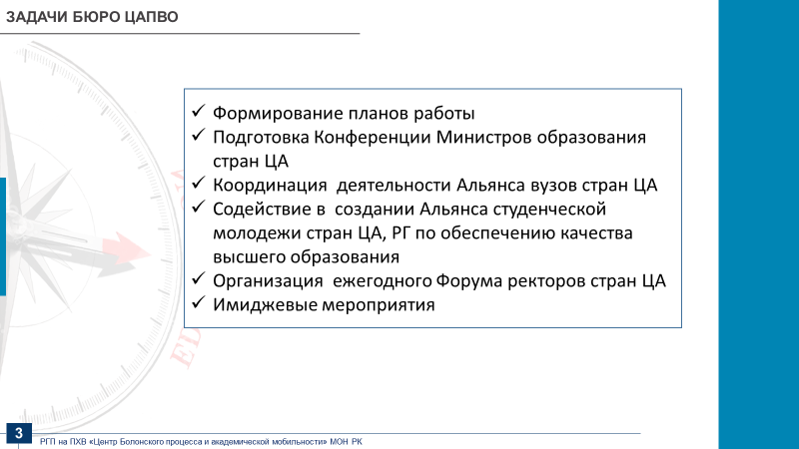
TASKS OF THE CAHEA BUREAU
Preparing and monitoring of work plans
Organizing the Conferences of CA Ministers of Education
Coordination of the activities of the Alliance of Central Asian Universities
Assisting in establishing the Central Asian Student Alliance and the Working Group on Quality Assurance in Higher Education
Organization of the annual Central Asian Rectors Forum
Methodological support for Central Asian Higher education organizations
Promotional events
9

Slide 17
FURTHER STEPS
Further work on promotion of the CAHEA
EHEA Ministers Conference and Global Policy Forum 2024, Tirana, Albania
11

Slide 18




Thanks for attention!

