Slide 1

Development of the Central Asian Higher Education Area
based on the principles of the Bologna Process
CG on Global Policy Dialogue
24 October 2022
K.A. Yergaliyev
MD MPH Dr.PH
Vice-minister of Science and Higher Education
of the Republic of Kazakhstan

Slide 2
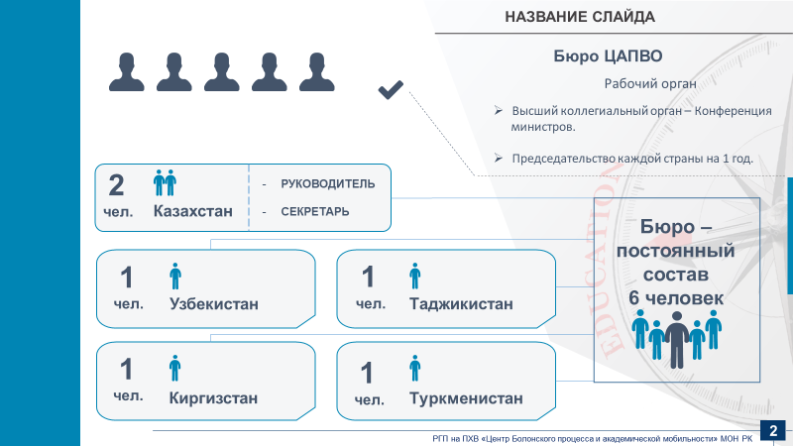

TuCAHEA – Tuning of Central Asia Higher Education Area
2012-2016
Purpose: to contribute to the development of the higher education area of Central Asia, in accordance with the European Higher Education area, to take into account and assess the specific needs and potentials of the region as a whole and partner countries in particular, responding to the needs of higher education in particular and society as a whole.
Results:
use of competence-based tools and tools to improve the quality of curriculum development
improvement of regional higher education systems
creation of a knowledge exchange platform
creation of pilot Tuning groups in subject areas
improvement of mobility tools: improving the quality and transparency of recognition.
TuCAHEA foundations have been laid for the formation of the NQFs and the use of ECTS in the region
2

Slide 3

CENTRAL ASIAN EDUCATION PLATFORM (CAEP)
2012-2015 (I), 2015-2019 (II)
Purpose: to contribute to the programs of the Central Asian countries aimed at improving the competitiveness and productivity of the national economy, as well as the potential for sustainable development in the region. The main objective was to provide the services necessary to ensure smooth progress in the implementation of the EU Education Platform in Central Asia, supporting its goals and activities as agreed between the EU and partners from Central Asia.
Results:
improved dialogue between Europe and Central Asia in the field of education
improved the quality of mutual learning in different countries
experience, lessons learned, exchange of best practices
evidence-based policy approach initiated
exchange of people and improvement of mutual understanding
improved support to local stakeholders for more effective implementation of reform programs at all institutional levels.
empowering policy makers through analysis and training.
3

Slide 4
The First Meeting of Ministers for Education of the Member States of the European Union and of the Central Asian Countries
Riga, 25 – 26 June 2015
in cooperation with the European Commission and the European External Action Service.
commitment to strengthen further mutual beneficial cooperation in the field of education, within the context of the EU-Central Asia Strategy
Main points of the Joint Communique:
Development of Qualification Frameworks (QF) and Standards
Quality Assurance (QA) and Accreditation
Employment and Labour Market Needs
Indicative Roadmap of Activities under the “Central Asian Education Platform” (2015-2018)
4

Slide 5
The Second Meeting of Ministers for Education of the Member States of the European Union and of the Central Asian Countries
within the framework of the European Union - Central Asia Education Platform (CAEP) project
Dissemination the ideas of the Bologna Process in the Central Asian region
Development of Central Asian Higher Education Area
The Astana Declaration was signed
The declaration intends to expand educational cooperation between the EU and Central Asian countries.
Main points of the Astana Declaration
Strengthening mutual cooperation on internationalisation issues in education
Capacity building and mobility in Higher Education
Recognition of non-formal and informal learning
Reforms in Vocational Education and Training to strengthen links between business, labour market needs and education actors
Astana, 23 June, 2017
5

Slide 6
Conference of Central Asian Education Ministers
Turkestan city, 17-18 June, 2021
The Turkestan Declaration was adopted, in which the Ministers of education of Central Asian countries proclaimed the creation of the Central Asian Higher Education Area (CAHEA).
The main objectives of the CAHEA laid down in the Turkestan Declaration:
development of comparable National Qualifications Frameworks;
optimization of procedures for the recognition of documents on education, academic degrees and titles;
implementation of comparable credits on the type of ECTS;
supporting the regional mobility of students, faculty and academic staff by ensuring the recognition and crediting of periods of study;
ensuring the quality of education in order to develop comparable criteria and methodologies;
cooperation in the development of educational programs, joint programs of study, practical training and research;
providing targeted grants for citizens of countries that have acceded to this Declaration to study in higher education institutions.
6

Slide 7
Central Asian University Rectors' Forum
Almaty, 12-13 May, 2022
Memorandum on the Establishment of the Alliance of Central Asian Universities was signed
The establishment of the Alliance contributes to
the partnership in the field of education and science, expansion of international educational and scientific cooperation of researchers and teachers between the universities of the Alliance in order to improve the quality, inclusiveness and competitiveness of higher education in Central Asia.
38 bilateral agreements between universities of Kazakhstan, Kyrgyzstan, Tajikistan and Uzbekistan were signed (13 Kazakhstani universities, 18 partner universities).
Recommendations of Central Asian Rectors and the Work Plan of the Alliance of Central Asian Universities were adopted.
7

Slide 8

The CAHEA Bureau
Working body
The highest collegial body of the Conference
of ministers
Annual Chairmanship
HEAD
SECRETARY
Kazakhstan
The Bureau -
permanent staff
6 people
Kyrgyzstan
Tajikistan
Turkmenistan
Uzbekistan
8

Slide 9
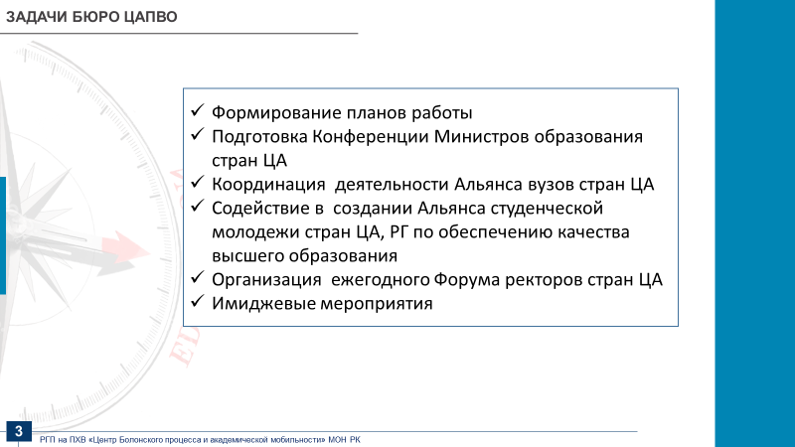
TASKS OF THE CAHEA BUREAU
Formation of work plans
Preparation of the Conference of Ministers of Education of Central Asia
Coordination of the activities of the Alliance of Central Asian Universities
Assist in establishing the Central Asian Student Alliance and the Working Group on Quality Assurance in Higher Education
Organization of the annual Central Asian Rectors Forum
Promotional events
9

Slide 10
Joint statement on the results of the Rectors' Conference with the participation of representatives of the BFUG, ministries and universities of Central Asia
Astana, 6 October 2022
working on agreed mechanisms for mutual recognition of educational documents within the Central Asian Higher Education Area
development of unified approaches to quality assurance of higher education based on European Standards and guidelines for quality Assurance (ESG).
regular meetings of the highest body of the Central Asian Higher Education Area - the Ministerial Conference
create an executive body – the Bureau of the Central Asian Higher Education Area on parity terms
Bureau of the Central Asian Higher Education Area will operate on the basis of the Ministry of Science and Higher Education of the Republic of Kazakhstan.
10

Slide 11
FURTHER STEPS
Further work on promotion of the CAHEA
EHEA Ministers Conference and Global Policy Forum 2024, Tirana, Albania
11

Slide 12




Thanks for attention!

